Slide 1


Lung Cancer Prediction Model Using Machine Learning Models
Name : Manish Kumar Das
Reg No. 12017595
Roll No. A71
Mentor : Mr. Ved Prakash Chaubey

Slide 2

ABSTRACT
Lung cancer remains a significant health concern with high mortality rates. Early detection is critical for improving patient prognosis. This study explores the potential of machine learning (ML) models for predicting lung cancer risk using data files.
We aim to develop and evaluate various ML models trained on patient data containing demographic information, medical history, smoking habits, and potentially biomolecular or imaging data. The data will undergo preprocessing to ensure compatibility with the chosen ML algorithms.
Our primary objective is to identify the most effective ML model in predicting lung cancer risk within this dataset. We will assess the model's accuracy through validation techniques. Additionally, the chosen model may offer insights into the most influential factors associated with lung cancer development.
This research has the potential to contribute significantly to the development of efficient lung cancer prediction tools. Early detection through such tools can enable timely interventions and improve patient outcomes. By leveraging the power of ML, this study aims to advance lung cancer diagnosis and potentially save lives.
Keywords: Convolutional Neural Network, Machine Learning, Web Application, Teras, TensorFlow, Supervised Learning, Unsupervised Learning, Semi-Supervised Learning.

Slide 3
INTRODUCTION
While lung cancer remains world's foremost cause of death outcomes for patients are dramatically improved with early detection. Machine learning (ML) and artificial intelligence (AI) are prominent tools in this endeavour, fundamentally altering the approach towards lung cancer diagnosis. The objective of this project is to explore crafting a machine learning model. This model will be able to analyse medical images. These images can include CT scans or chest X-rays. The aim is to identify potential cases of lung cancer. Utilising the power of ML algorithms our objectives are as follows:
Enhance Accuracy: Algorithm we develop seeks to identify lung cancer with a higher degree of precision than traditional techniques. This could reduce the number of diagnoses that are missed.
Promote Early Detection: Timely detection is crucial for effective treatment. The software will be trained to detect subtle signs of early-stage lung cancer.
Support for Radiologists: We envision the model as an essential tool for radiologists. It will highlight areas of concern, simplifying their workflow.
The potential for research to monumentally impact lung cancer diagnosis is high. It accomplishes this by assisting in early detection while enhancing overall accuracy. ML models can contribute in a profound way to improved patient outcomes. Their contribution could potentially save lives. This introduction readies the ground for your project. It highlights the significance of lung cancer detection and the role of AI and ML.

Slide 4

HYPOTHESIS
1. Hypothesis 1 (Emphasizing Improved Accuracy): Comparatively a machine learning model, trained on sizable and varied dataset can surpass traditional diagnostic techniques. These conventional techniques include radiologists' visual inspection of chest X-rays or CT scans. The model can achieve greater accuracy in identifying lung cancer. The theory points to the greater overall accuracy of machine learning models. Machine learning models are potentially superior to current techniques.
2. Hypothesis 2 (Early Detection): A machine learning model could be custom-built. It's tailored to recognize subtle details in chest X-rays. Such details indicate early stages of lung cancer. With this, treatment-effectiveness might be maximized. Traditional methods may be outperformed by this model. This hypothesis revolves around early lung cancer detection by machine learning algorithms. It suggests improved patient outcomes as a potential result.

Slide 5

RESEARCH GAPS
Despite the advancements in ML-based lung cancer detection, there are crucial areas requiring further exploration:
Data Bias and Generalizability: Current models might be biased towards specific data sources or image characteristics. This can lead to inaccurate results for populations not well-represented in the training data. Research is needed on techniques to debias datasets and improve generalizability across diverse patient populations.
Explainability and Interpretability: "Black box" models are difficult for doctors to understand and trust. Research is needed on developing models that can explain their reasoning behind a detection, allowing doctors to integrate the model's insights with their clinical expertise.
False Positives and Negatives: ML models can misclassify benign nodules as cancerous, leading to unnecessary biopsies. Conversely, they might miss true cancers. Research is needed on improving model accuracy and reducing false positives/negatives.
Integration with Clinical Workflow: Seamless integration of ML models into existing clinical workflows is crucial for real-world adoption. Research is needed on developing user-friendly interfaces and decision support systems that leverage ML outputs effectively.
Incorporating Additional Data: Current models primarily rely on imaging data. Research on incorporating clinical history, genetic information, and other relevant data points could improve model performance and personalize risk assessments.

Slide 6
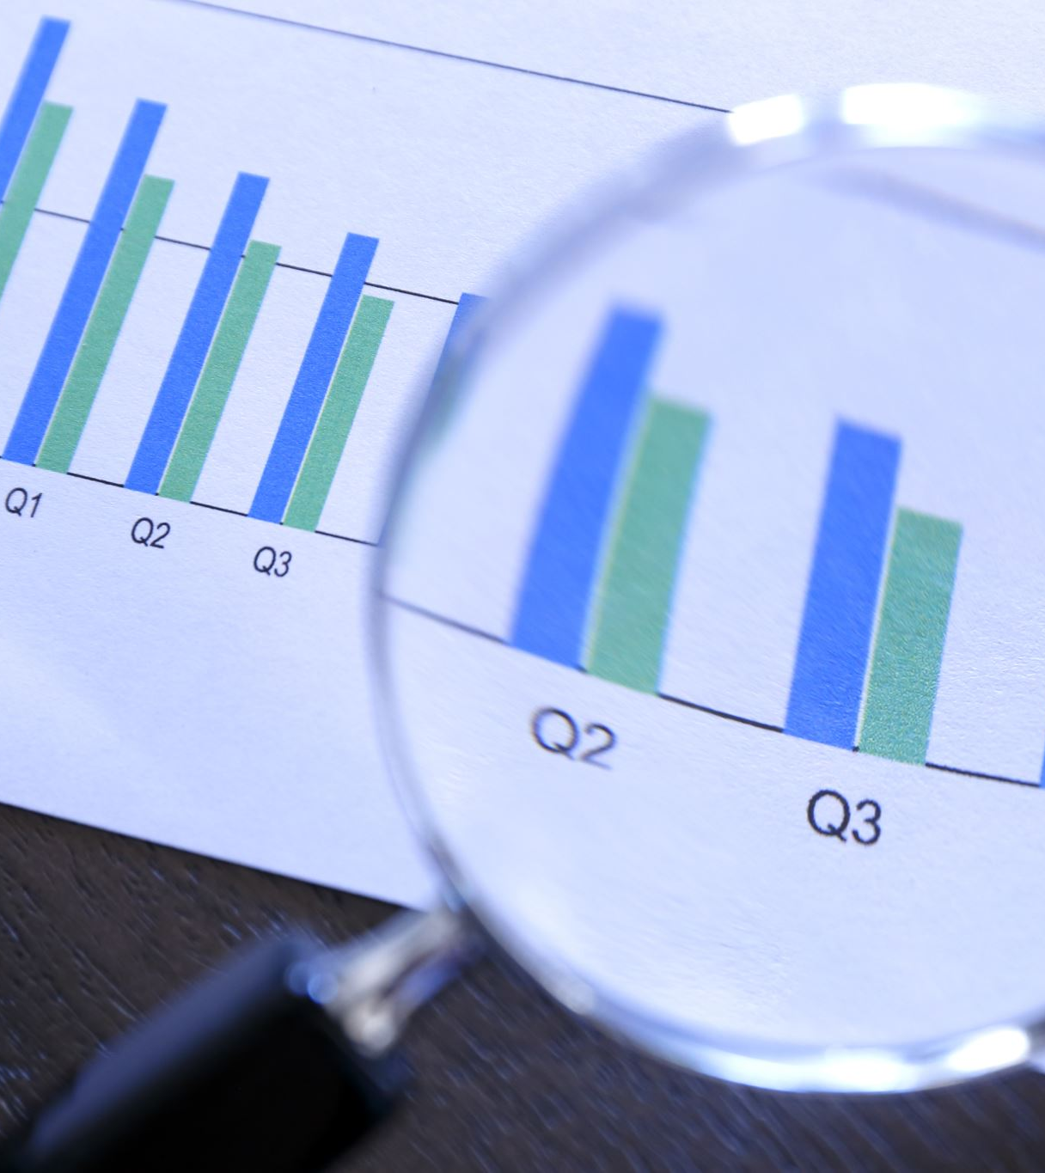
METHODOLOGY
This methodology outlines the development of a lung cancer detection model using supervised learning and patient-reported symptoms.
1. Data Acquisition:
Collect data: Gather data from medical institutions or patient surveys containing patient demographics, smoking history, and a comprehensive list of lung cancer symptoms (cough, weight loss, chest pain, etc.). Ensure data anonymization adheres to ethical guidelines.
2. Data Preprocessing:
Data cleaning: Address missing values, inconsistencies, and outliers in the data. Employ techniques like imputation, data normalization, and outlier removal.
Feature engineering: Extract relevant features from the raw data. This might involve creating new features based on combinations of symptoms or symptom duration.
3. Model Selection and Training:
Choose a supervised learning algorithm: Popular choices for classification problems include Logistic Regression, Random Forests, Support Vector Machines (SVM), or Gradient Boosting.
Split data: Divide the data into training, validation, and testing sets. The training set is used to build the model, the validation set for hyperparameter tuning, and the testing set for final performance evaluation.
Train the model: Train the chosen algorithm on the training data, adjusting hyperparameters (model settings) to optimize performance on the validation set.
4. Model Evaluation:
Evaluate performance: Measure the model's accuracy, precision, recall, and F1-score on the held-out testing set. These metrics assess the model's ability to correctly classify patients with and without lung cancer.
Interpret results: Analyse the model's performance to understand which symptoms contribute most to the prediction.

Slide 7

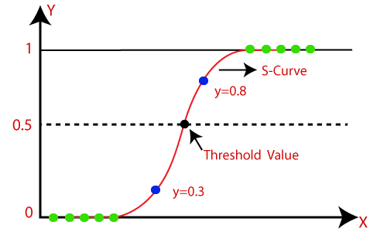
LOGISTIC REGRESSION MODEL
Logistic regression is a workhorse in the world of machine learning, particularly useful for classifying things into two categories. Imagine you want to predict whether an email is spam or not, or if a patient has a certain disease based on symptoms. This is where logistic regression shines. Unlike its cousin linear regression, which predicts continuous values, logistic regression deals with binary outcomes – yes/no, 0/1, positive/negative. But how does it make the call?
Logistic regression builds a mathematical model using a sigmoid function, which looks like an S-shaped curve. This function takes a bunch of input features (like email content or patient data) and transforms them into a probability between 0 and 1. A value closer to 1 suggests a high chance of belonging to one category (e.g., spam), while a value closer to 0 indicates the other (not spam).
The key is training the model with existing data where the outcome is already known. This allows logistic regression to learn the relationships between features and the desired outcome, enabling it to make predictions on new data. Overall, logistic regression is a powerful tool for classification tasks, offering a clear probability estimate for each prediction. Its ease of interpretation and implementation makes it a popular choice for various applications in machine learning.

Slide 8

Decision Tree Model
Imagine a flowchart that helps you make decisions based on a series of questions. That's the essence of a decision tree algorithm, a powerful tool in machine learning.
This supervised learning method works by building a tree structure where:
Internal nodes represent questions based on features of your data (like weather for predicting picnics).
Branches represent the possible answers (sunny/rainy).
Leaf nodes represent the outcome (picnic possible/cancelled).
The algorithm trains itself by recursively splitting the data into subsets based on the most informative feature at each step. It aims to minimize randomness (impurity) in the resulting subsets, leading to more accurate predictions.
Decision trees are versatile. They can handle both classification (spam/not spam) and regression (predicting house prices) tasks. They're also interpretable, allowing you to understand the logic behind their predictions.
However, decision trees can become overly complex and prone to overfitting if not carefully controlled. Nevertheless, they remain a fundamental algorithm for various machine learning applications.

Slide 9
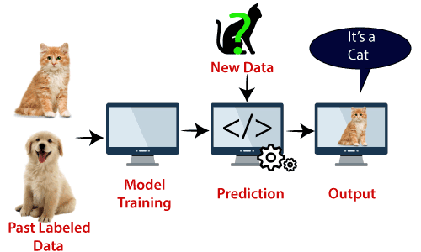
Support Vector Machine Model
Support Vector Machines (SVMs) are another powerful supervised learning technique, tackling both classification and regression problems. Imagine you have data points representing apples and oranges, and you want to draw a clear boundary to separate them. SVMs excel at this kind of task.
Instead of a simple line like logistic regression, SVMs find a hyperplane (a plane in higher dimensions) that best divides the data points into their respective classes. But SVMs are picky – they aim for the widest possible margin between the hyperplane and the closest data points from each class. These closest data points are called support vectors, and they essentially define the decision boundary.
The wider the margin, the more robust the SVM's classification is to unseen data. This makes SVMs effective even with complex datasets. However, SVMs can struggle with high-dimensional data or data with a lot of noise.
Another advantage of SVMs is their focus on the data points that matter most – the support vectors. This allows for a potentially more efficient model compared to other algorithms. Overall, SVMs are a versatile tool for classification tasks, offering good performance and interpretability in many scenarios.

Slide 10
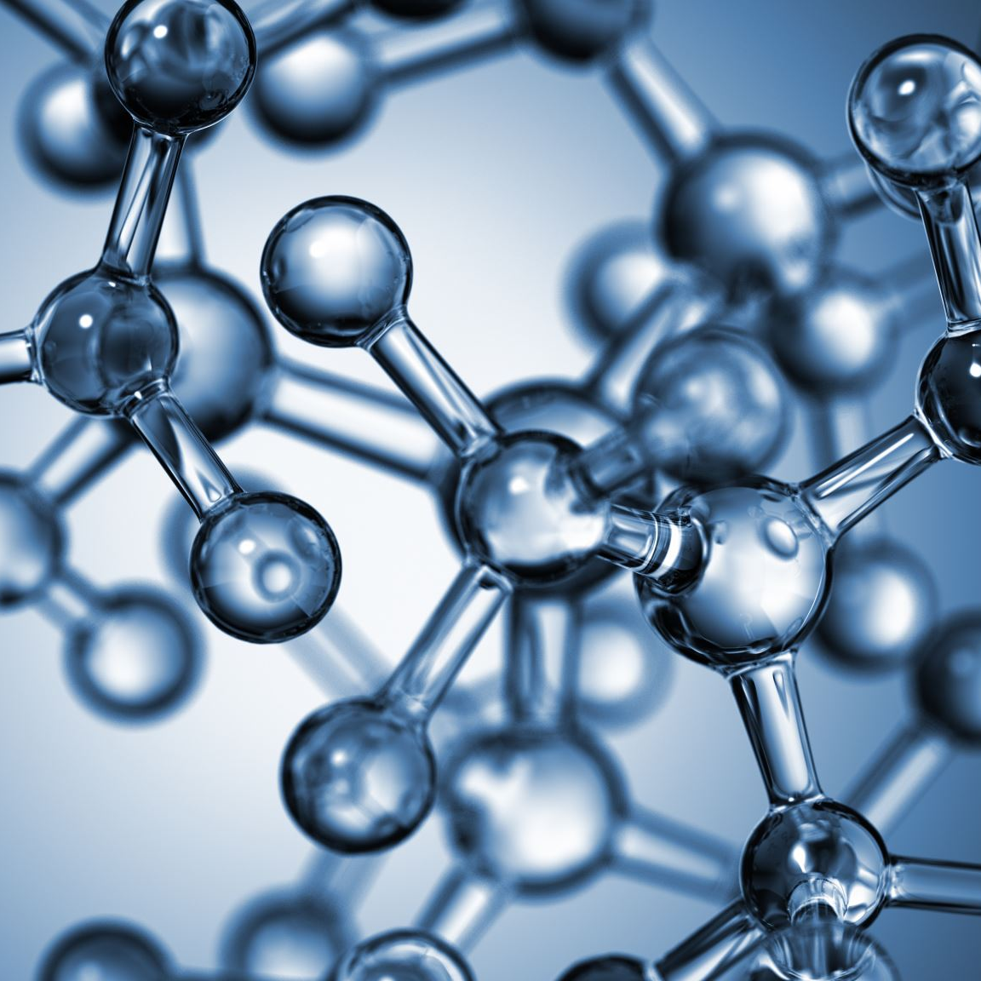
Naïve Bayes Algorithm
Naive Bayes, another champion in the machine learning classification arena, tackles problems with multiple categories, not just two. Imagine sorting emails into spam, important, or promotional folders. Here's where Naive Bayes comes in.
Despite its "naive" name, it's surprisingly effective. Naive Bayes is based on Bayes' theorem, a powerful tool for calculating probabilities. The "naive" part comes from its assumption that features, like words in an email, are independent of each other given the category (spam/important). For an email, Naive Bayes calculates the probability of it being spam considering each word individually. Then, it multiplies these probabilities to get a final spam probability score. The same is done for other categories (important, promotional). The email is assigned to the category with the highest score.
Training involves feeding Naive Bayes a bunch of pre-categorized emails. This lets it learn the probabilities of words appearing in each category. With this knowledge, it can analyse new emails and classify them efficiently. Naive Bayes' simplicity and speed make it a popular choice for text classification, spam filtering, and sentiment analysis. However, its independence assumption isn't always perfect, and it might struggle with complex relationships between features.

Slide 11
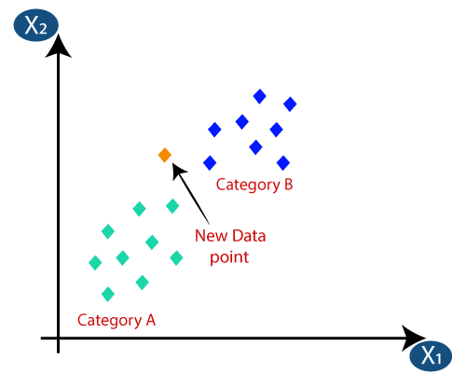
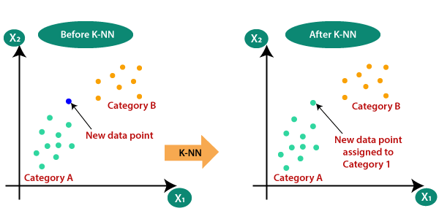
K-NEAREST NEIGHBOUR (KNN)
K-Nearest Neighbours (KNN) is a straightforward and versatile algorithm in machine learning, used for both classification and regression tasks. Imagine you're at a party and want to know someone's interests. KNN assumes people close to each other (your neighbours) likely share similar interests. So, to predict someone's preferences, KNN identifies the closest k people (based on a chosen distance metric) and examines their interests.
Training: KNN doesn't require complex training. It simply stores all existing data points.
Prediction: When a new data point arrives, KNN calculates the distance to all stored points. It then identifies the k closest neighbours (k is a user-defined parameter).
Classification: For classification, KNN predicts the class (category) that's most frequent among the k neighbours. Imagine your k closest partygoers are mostly into sports, so KNN predicts you'll enjoy sports too.
Regression: For regression, KNN predicts the value for the new data point by averaging the values of its k neighbours.
KNN's strength lies in its simplicity and ability to handle various data types. However, it requires storing all training data, which can be memory-intensive for large datasets. Additionally, choosing the optimal value for k is crucial for accurate predictions.

Slide 12
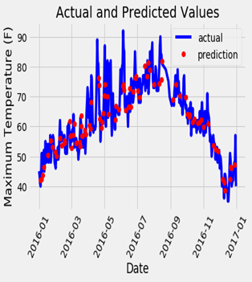
RANDOM FOREST ALGORITHM
Random Forest: A powerful ensemble learning technique that combines multiple decision trees for improved prediction accuracy. It addresses the overfitting issue common in single decision trees.
Forest of Wisdom: Builds a "forest" of decision trees, each trained on a random subset of data and features. Final predictions are made by majority vote (classification) or averaging (regression).
Strength in Numbers: Reduces variance and improves model robustness compared to single decision trees.

Slide 13
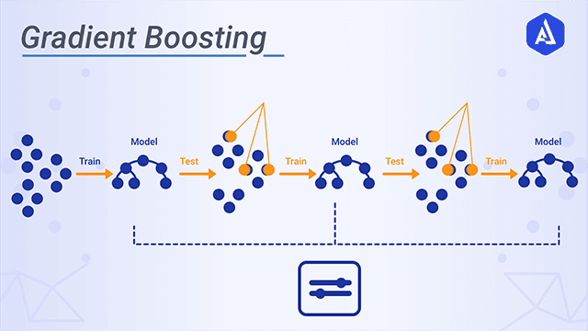
GRADIENT BOOST ALGORITHM
Gradient boosting is a super smart machine learning technique that can do both predicting numbers and classifying things well. Just imagine it like a team, where everyone learns from each other’s mistakes. It all starts with a basic prediction model, usually a simple decision tree. Teamwork is the key to success: We create a new model that fixes the mistakes of the first one, making it even better. We keep going back and forth, making new models, and focusing on the mistakes, and then putting them all together. Gradient boosting keeps getting better by adding more focused learners. It’s like a team that’s always learning and improving, getting better with each challenge. way of saying: This method makes gradient boosting good at dealing with complicated data and helps it not overfit.

Slide 14
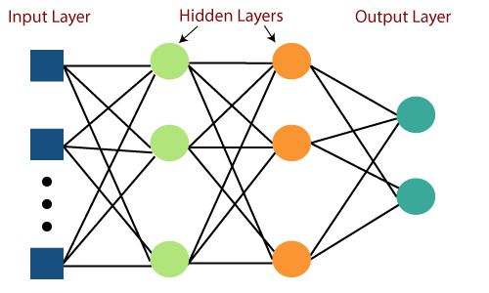
MULTI-LAYER PERCEPTRON
The Multilayer Perceptron (MLP) is a powerful neural network used to solve more complex problems unlike Logistic Regression. Imagine a layered network of interconnected processing units, like a brain. This is the core of an MLP. MLP consists of an input layer, an output layer, and hidden layers in between. Each layer contains artificial neurons that process data, flowing forward through the network unlike Logistic Regression. Within each neuron, weighted connections influence input data. These weights act like dials, determining each input's impact. Activation functions add non-linearity, enabling MLP to uncover complex patterns in data that Logistic Regression cannot.

Slide 15
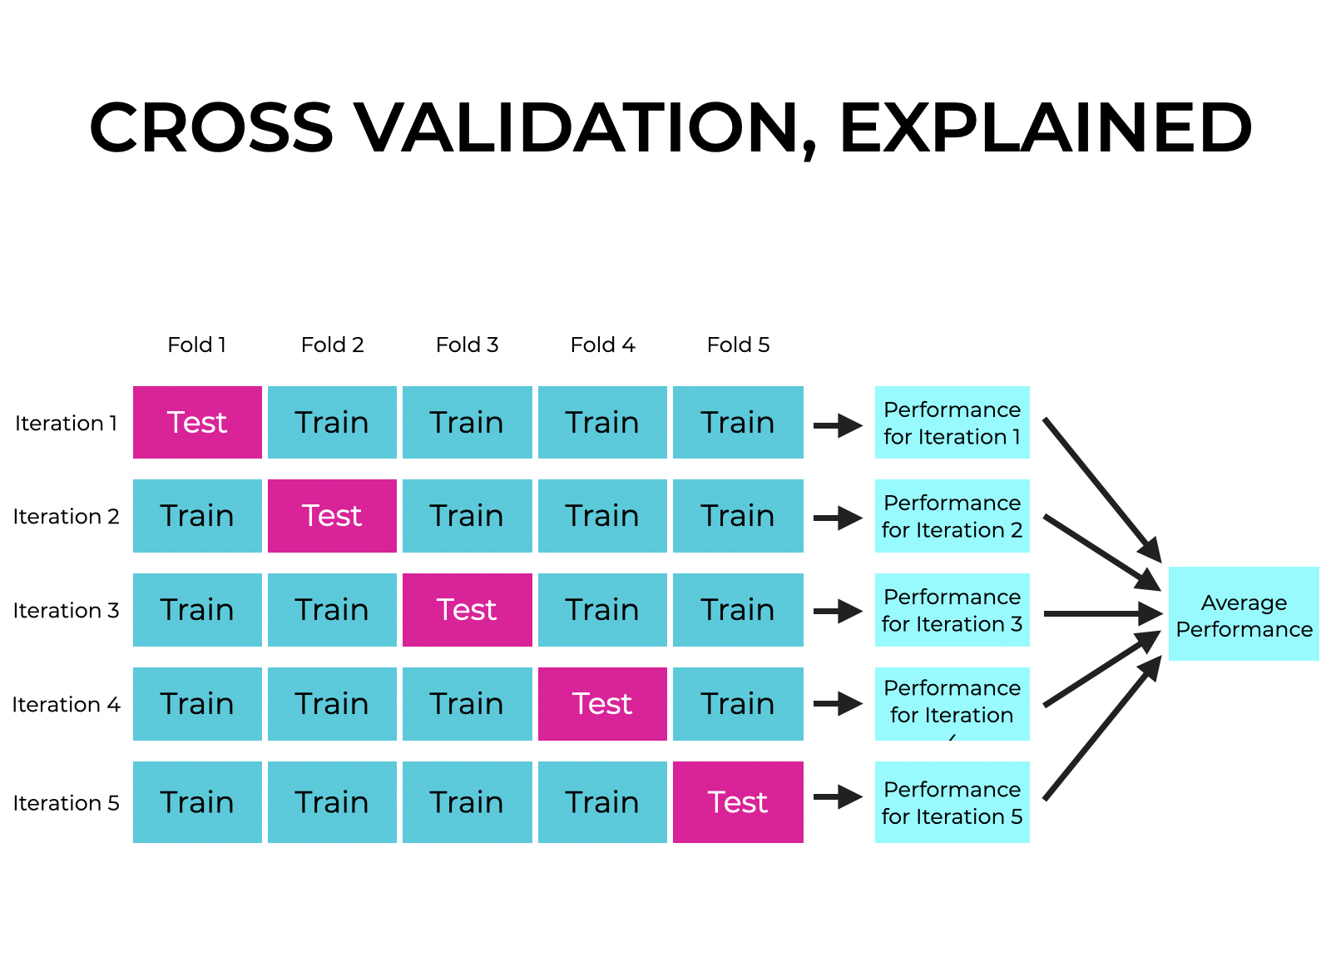
CROSS- VALIDATION
In machine learning, when training models to make accurate predictions, the ability of the model to perform well on previously unseen data is essential. To ensure this, cross-validation is a technique that helps avoid overfitting. Overfitting occurs when a model performs well on the specific data it was trained on but struggles to predict on new data. Cross-validation involves:
1. Data Division: Splitting the available data into multiple sets called "folds" (commonly 5 or 10).
2. Train-Test Split: In each iteration, one-fold is designated as the test set (validation set), while the remaining folds are used for training.
3. Model Training: Training the model using the training data.
4. Performance Evaluation: Using the validation set to test the performance of the trained model.
5. Repetition: Repeating steps 2-4 for all folds. Cross-validation allows the model to be tested on different sets of unseen data, providing a better understanding of its accuracy and generalization ability.

Slide 16
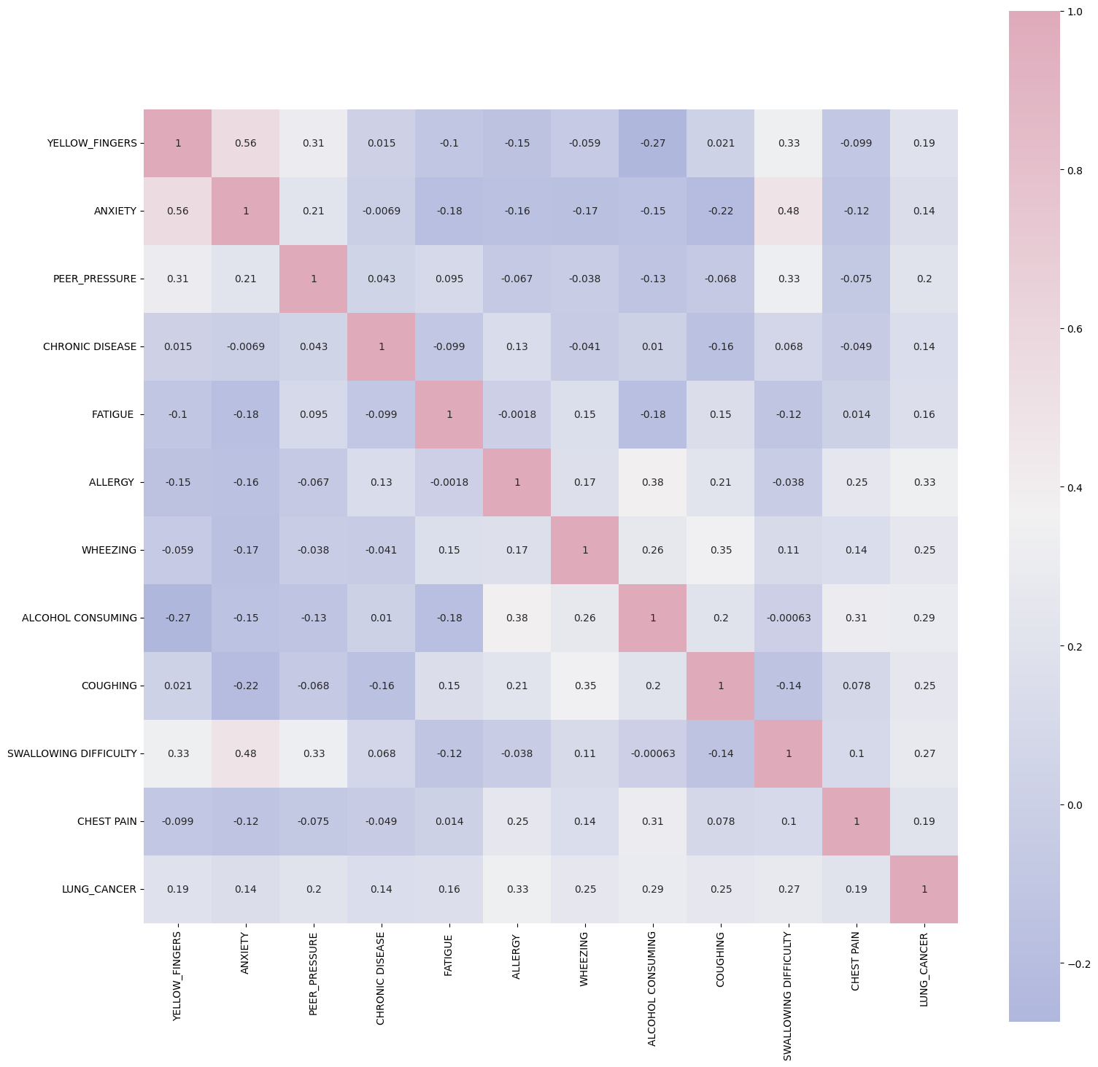
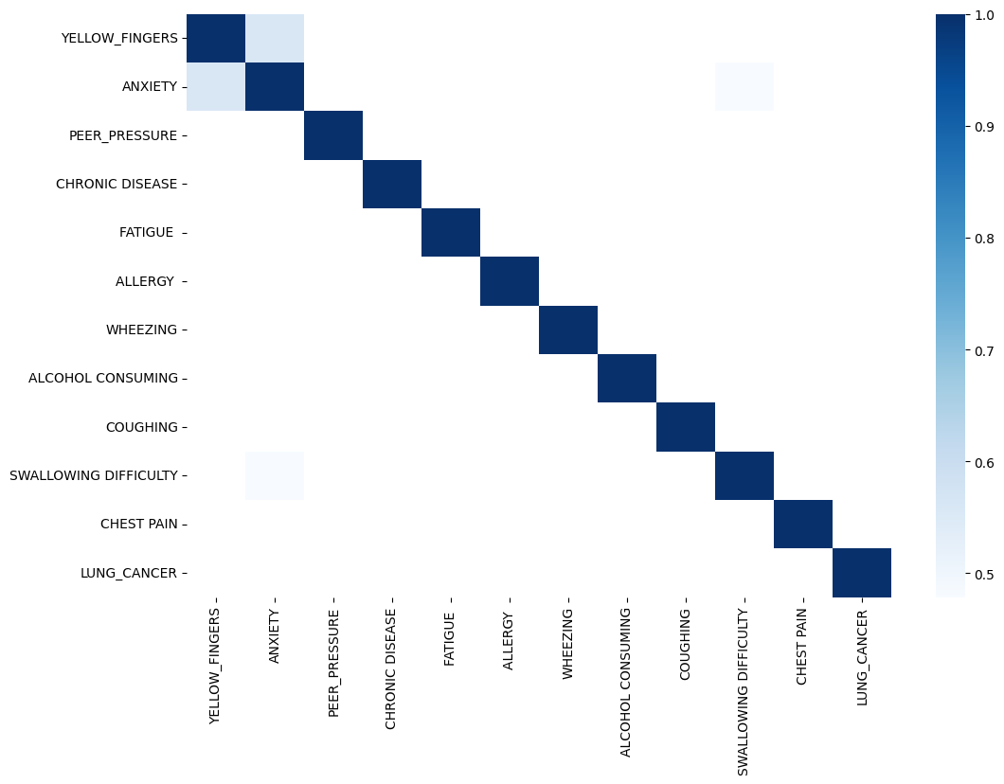

Slide 17
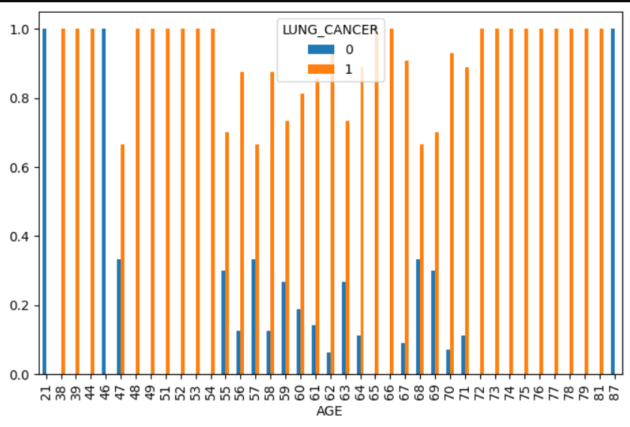

Slide 18
RESULT AND DISCUSSION
Positive Results:
High Accuracy: Studies report promising accuracy rates, with some models achieving over 90% accuracy in differentiating cancerous from benign lung nodules on CT scans.
Early Detection: ML models can potentially identify lung cancer at earlier stages when treatment is more effective, leading to better patient outcomes.
Data-driven Insights: Extracting features from medical data using ML can reveal previously unknown patterns or relationships, aiding in improved diagnosis and risk assessment.
Discussion Points and Considerations:
Data Quality and Generalizability: Model performance heavily relies on the quality and comprehensiveness of training data. Biases or limitations in data can affect generalizability to real-world populations.
Overfitting and Explainability: Complex models can be overfit to training data, impacting performance on unseen data. Explainable AI (XAI) techniques are crucial to understand the model's reasoning and ensure trust in its predictions.
Integration with Clinical Workflow: For successful adoption, seamless integration of ML models with existing healthcare workflows and electronic health records (EHR) systems is essential.
Positive Results:
High Accuracy: Studies report promising accuracy rates, with some models achieving over 90% accuracy in differentiating cancerous from benign lung nodules on CT scans.
Early Detection: ML models can potentially identify lung cancer at earlier stages when treatment is more effective, leading to better patient outcomes.
Data-driven Insights: Extracting features from medical data using ML can reveal previously unknown patterns or relationships, aiding in improved diagnosis and risk assessment.

Slide 19

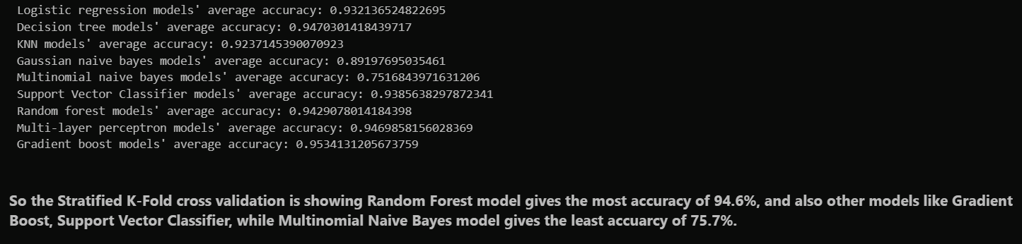
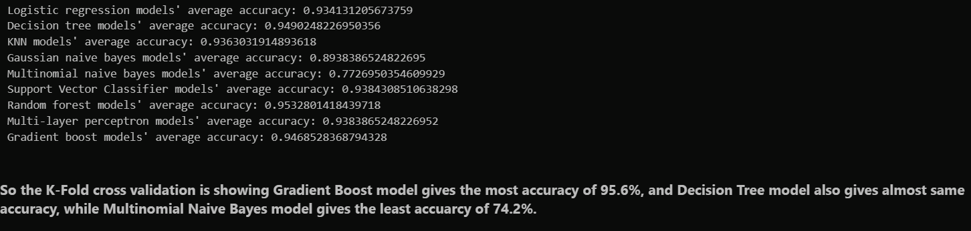

Slide 20

THANK YOU

